Slide 1


550 West Elm Street
Lima, OH
Lima Area
Affiliate
www.habitatlima.org
Notes:
Welcome. I appreciate the time you have given me to share about the Lima Area Habitat for Humanity and its current programs.

Slide 2
What is
Habitat for Humanity?
Our mission: Seeking to put God’s love into action, Habitat for Humanity brings people together to build homes, communities and hope.
Our vision: A world where everyone has a decent place to live
Notes:
The mission statement is what drives our organization. We believe that we can create a world where everyone does have access to decent, affordable housing. It is a joy to work at this, one homeowner at a time.

Slide 3
The world is in a global housing crisis.
827 million people live in urban slums
By 2030 about 3 billion people, or 40 percent of the world’s population, will need proper housing and access to basic infrastructure such as water and sanitation systems.
Notes:
Here are some sobering facts about our world today.

Slide 4
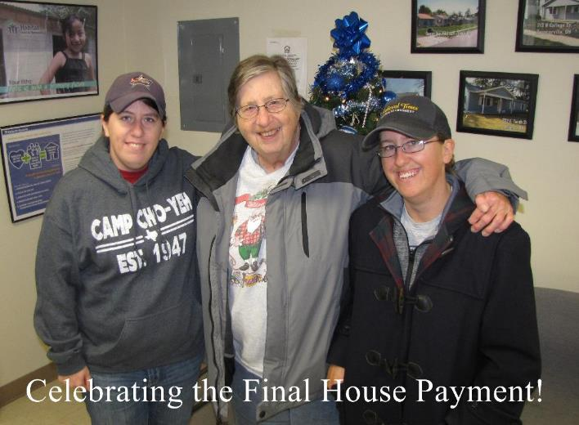
This is why habitat for humanity exists
Notes:
Habitat for Humanity is dedicated to eliminating substandard housing and homelessness worldwide and to making adequate, affordable shelter a matter of conscience and action. Our ministry was founded on the conviction that every man, woman and child should have a simple, decent place to live in dignity and safety.
We are driven by the desire to give tangible expression to the love of God through the work of eliminating poverty housing.

Slide 5
Habitat for Humanity’s principles
Demonstrate the love of Jesus Christ.
Focus on shelter.
Advocate for affordable housing.
Promote dignity and hope.
Support sustainable and transformational development.
Together, we can do this!
Notes:
Note the five principles that we have, especially the first one: This is why we do this!

Slide 6
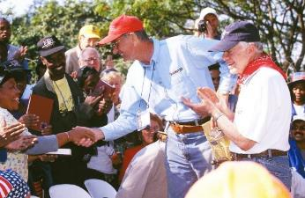
Facts about Habitat for Humanity
Worldwide, nonprofit, ecumenical Christian organization
Started in 1976 by
Millard and Linda Fuller
Influenced by Koinonia Farm
and its concept of partnership
housing
Jimmy and Rosalynn Carter got involved in 1984
International headquarters in Americus, Georgia
Administrative headquarters in Atlanta
Notes:
Fast Facts
We are a Christian organization
The Fullers were inspired to create Habitat after their involvement with Koinonia Farm and its founder Clarence Jordan, who utilized the idea of partnership housing.
Habitat’s most famous volunteers, Jimmy and Rosalynn Carter, are NOT the founders of organization, but they helped to bring it into more mainstream media.

Slide 7

More Facts about Habitat
Habitat for Humanity does NOT give away houses
Habitat DOES build affordable houses with a zero percent interest mortgage
Notes:
One myth about Habitat is that we give away houses. Our Habitat homeowners pay a regular mortgage like anyone else. What we do offer is help for those who would not normally be approved for a home mortgage loan. Because of the lower cost of the home (through volunteer help and sponsor support) and a zero percent interest mortgage, we are able to offer a “hand up”, not a “hand out”. We make sure that the mortgage fits the family income and is no more than 30% of their income.

Slide 8
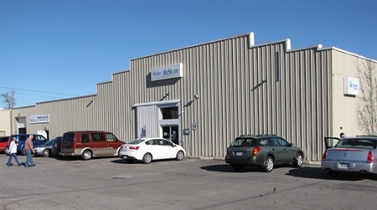
Facts about the Lima Affiliate
The Lima area affiliate was founded in 1991.
We are one of nearly 1,400 affiliates across the United States, in all 50 states, and in approximately 70 countries around the world
Notes:
We used to be located on Wayne Street, but moved to our current location at 550 W. Elm Street in 2012.

Slide 9
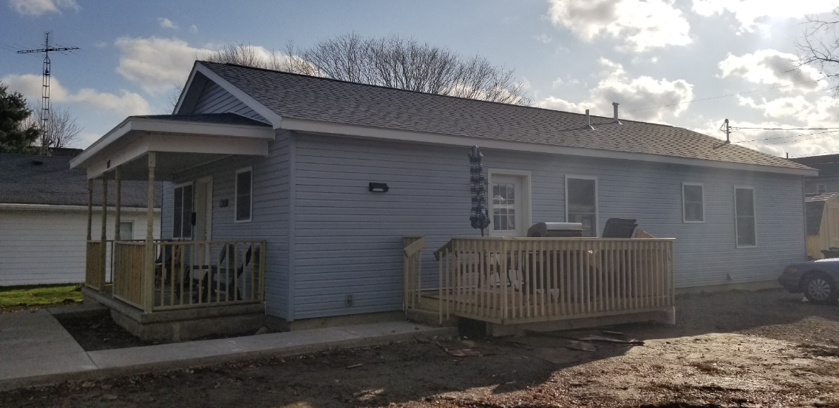
Lima Affiliate’s most recent build
Notes:
Our last completed house, #55, was in Elida. This house is part of a continued area need for quality affordable housing. We have built houses in Lima, Spencerville, Delphos and now in Elida.

Slide 10
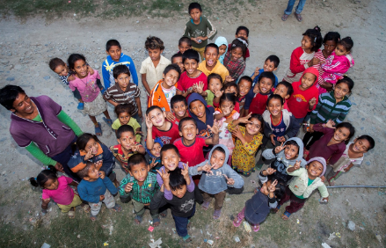

More Facts about the Lima Affiliate
The Lima affiliate tithes internationally to both Guatemala and Africa/Middle East.
Our affiliate has been a partner of HFH Guatemala since 2006, and throughout these 13 years has tithed $105,407.84 towards reducing the housing deficit in Guatemala.
Notes:
Building houses in the Lima area is not the only place where our time and money go. Note the international connections.
We tithe 10% of our unrestricted donations and income.

Slide 11


Why Should you support habitat?
Notes:
As human beings, we want to be generous: with our time, our money, and our lives. Millard Fuller, HFH founder, gave up the “American Dream” and riches in order to have a fulfilling life helping others. He was a millionaire, but with a failing marriage and no real motivation to keep living the way he was, he discovered what was truly important in life – the joy of being generous towards others.

Slide 12
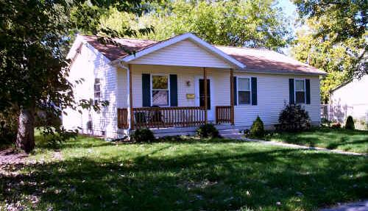
We Help Build a Better Community
Decent, affordable housing is key
to improving every community.
Notes:
The reality is that health and education suffer and job opportunities diminish if affordable housing is not available. [The United Nations estimates that more than one billion people around the world live in substandard housing — including millions in the United States.]

Slide 13
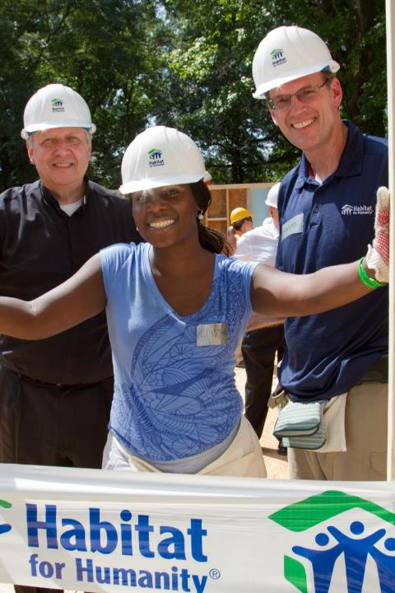
We Help build partnerships
*Corporate
*Community
*Faith-Based
*Private *Philanthropy
*Media
Notes:
There are many ways that Habitat partners with groups and individuals, helping us to provide decent, affordable shelter to families in need around the world. From corporations to churches to individual gifts and through prayer and the media, Habitat continues to impact others.

Slide 14


WE HELP
CHANGE LIVES
46.5 million people live
in poverty in the US
Notes:
Minimum wage is not keeping up with the rising cost of living and many workers struggle to afford decent housing.
Decent, stable housing provides more than just a roof over someone’s head
It offers
Stability for families and children.
Sense of dignity and pride.
Health, physical safety and security.
Increase of educational and job prospects.

Slide 15
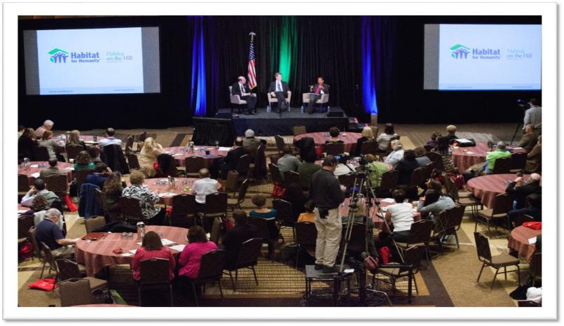
We advocate
Notes:
We, at Habitat, advocate for better and fair housing practices for the less fortunate. Smart policies and systems can promote helpful access to decent housing.

Slide 16
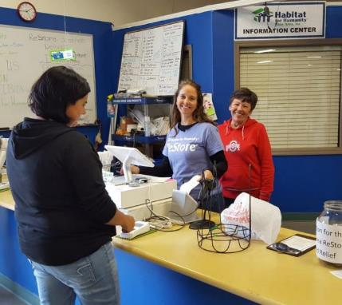
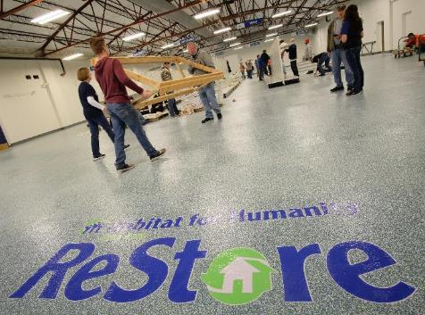
We ReStore
Notes:
Habitat for Humanity’s ReStores are nonprofit home improvement stores and donation centers that sell new and gently used furniture, home accessories, building materials and appliances to the public at a fraction of the retail price. Habitat for Humanity ReStores are proudly owned and operated by local Habitat for Humanity affiliates, and proceeds are used to build homes, community and hope locally and around the world. We are concerned about our environment and are pleased to recycle these goods.

Slide 17
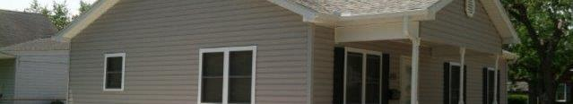

How can you help?
Notes:
We might not be able to change the whole world by ourselves, but each of us, along with others, can change a small part of the world. Over and over again I have been told that one of the most important reasons people donate to or volunteer for Habitat is that they truly have an opportunity to change at least a small portion of their community.

Slide 18

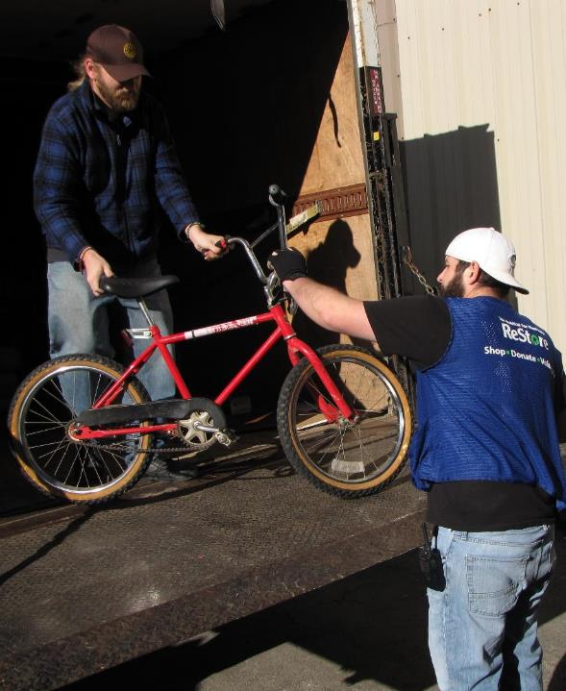
donate
Money
  One time donation
  No Place Like Home
  Club
  Square Foot Project
Sponsor a build
Donate items to
the ReStore
  New building materials
  Gently used items
Notes:
As you can see, there are many ways to donate. No Place Like Home Club is the primary fund-raising program of Habitat for Humanity Lima Area, Inc. The goal is for multiple people, each giving at least $10 a month to the Lima Affiliate. With a strong membership, the affiliate will be able to build multiple houses every year. You can also donate by the square foot. We can build one square foot of a Habitat house for just $62. Sponsoring a build means that businesses or churches or other groups make a commitment to help fund and build a new house.

Slide 19
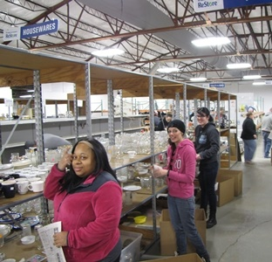
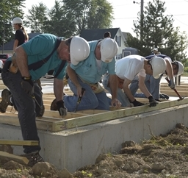
volunteer
As an individual
As a group
Opportunities
  Construction work
  ReStore volunteering
  Committee work
  Other skills
    Photography
    Web management
    Social Media facilitator
    Data Input
Notes:
There are many ways to volunteer. Not all of us are skilled at swinging a hammer. Some of us are thinkers, which makes for good board and committee members. Some of us are people persons who can assist others in work at the ReStore. Some of us have other skills that can be utilized by the Lima Area Affiliate.

Slide 20
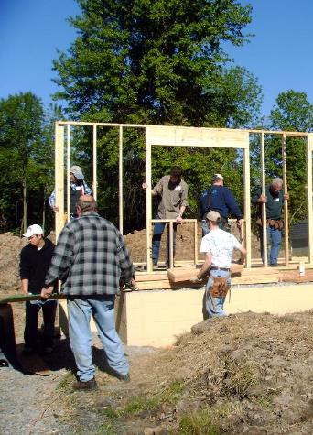
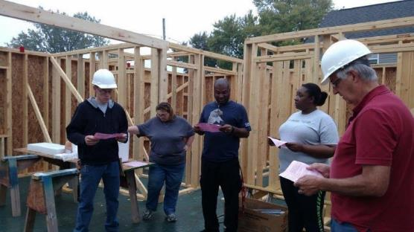
Construction volunteer opportunities
Insert Photo
Notes:
Habitat relies heavily on one-time and regular volunteers to aid the staff of Habitat Lima in achieving its goal of providing safe, affordable housing to families in the Lima area.

Slide 21
  Siding & Gutters/down spouts
  Roofing
  Painting
  Landscaping
  Drywall hanging and finishing
  Window and Door installation
  Electrical work
  Concrete work
  Floor covering
  Cabinetry & Countertops
  Providing lunch
  Tool repair
  Truck Repair
Notes:
Here is a list of some Construction tasks that are needed on each house.

Slide 22
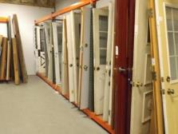
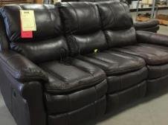
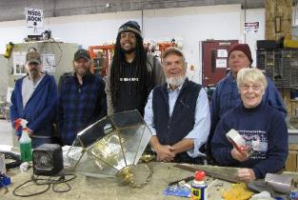
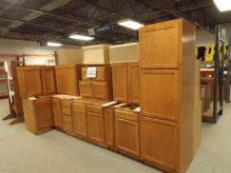

ReStore Volunteer opportunities
Come volunteer with us!
Notes:
Regular Volunteers
The Lima affiliate is greatly aided by its regular volunteers. We could use more. By committing to volunteer at least one day a week or month, regulars receive additional training and skills and lots of gratitude. Please consider making volunteering a regular part of your life.

Slide 23

  Cashiers / Office Staff / Marketing
  Product Preparation and Assistants
  Donation/Product Pick-up with ReStore Staff
  Construction, Cleanup and Maintenance
Notes:
Here are volunteer options in the ReStore.

Slide 24
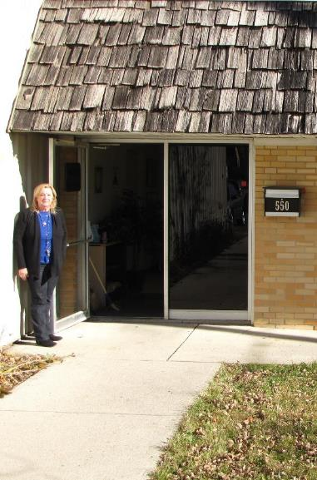
Administrative volunteers
The Habitat office is the hub of the organization.
Volunteers help with reception, filing, mailings, data entry, graphic design, web support and cleaning.
Volunteers make up our Board of Directors and Committee personnel.
Notes:
Office workers are also needed. Many of our volunteers do important work behind the scene as members of the Board of Directors or on one of our committees. Again, not all are gifted or called to build houses, but the Habitat affiliate needs volunteers with a wide variety of skills and interests.

Slide 25
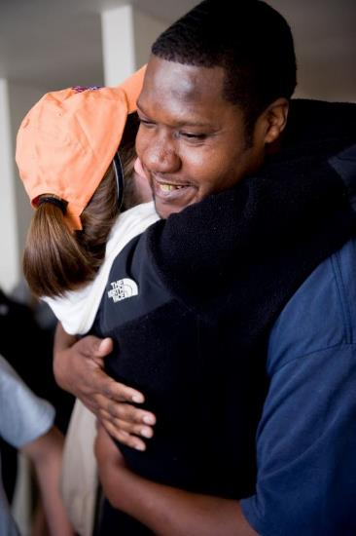
Benefits of volunteering
Practical
Relational
Emotional
Spiritual
Community, church, and corporate
groups, as well as individuals,
are welcome to part of the Habitat volunteer family.
Notes:
Volunteering benefits you
Practically—You learn new skills as you work
Relationally—You meet new people and connect with like-minded people
Emotionally—You feel good about your accomplishments
Spiritually—You grow from putting feet to your faith

Slide 26


Lima’s most Pressing needs
Notes:
We have one very pressing need currently.

Slide 27
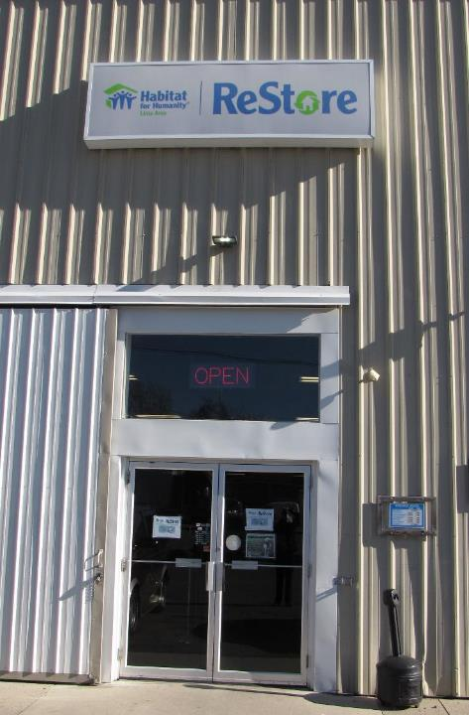
volunteers
Great need for additional volunteers in the ReStore
  Product preparation
  Customer Service personnel
  Donation/product pick-up
Continued help with construction volunteers as we build
Notes:
We could use up to 10 more volunteers per week to help keep up with all the generous donations that are coming into the store, as well as the many customers seeking help as they shop. Volunteers can come as individuals or as groups. We will also hope to be building again soon in Delphos in the spring of 2020.

Slide 28
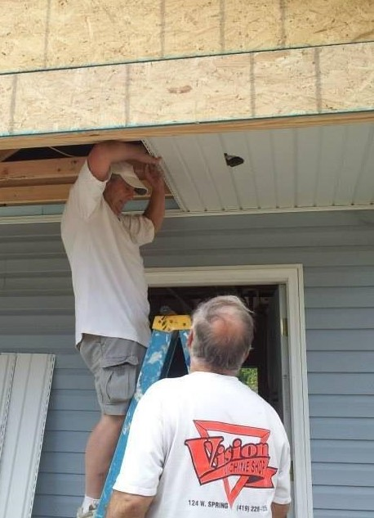
Repair program
Coming soon
More homes made livable
More people able to live a safer, healthier, and fuller life
Zero interest loans for the homeowners
Notes:
In order to serve even more families in the Lima area, our affiliate looking into starting a house repair program. Like our homeownership program, the costs for this program will be kept low with volunteer labor and then paid off through zero interest loans by the homeowners.

Slide 29
Team Building Volunteer Day
Volunteering for a Better Community
(Performing community service as an organization)
    Day will include:
        Orientation
        Volunteering at the ReStore
        Habitat gift
        Lunch, if working 4+ hours
        Time for internal group activities, if desired
        Conference room will be reserved for the group
Notes:
Tuesdays or Saturdays would be ideal. Just contact me at any time to set up a day. Groups of 6-10 would work best, but we can make adjustments smaller or larger.

Slide 30
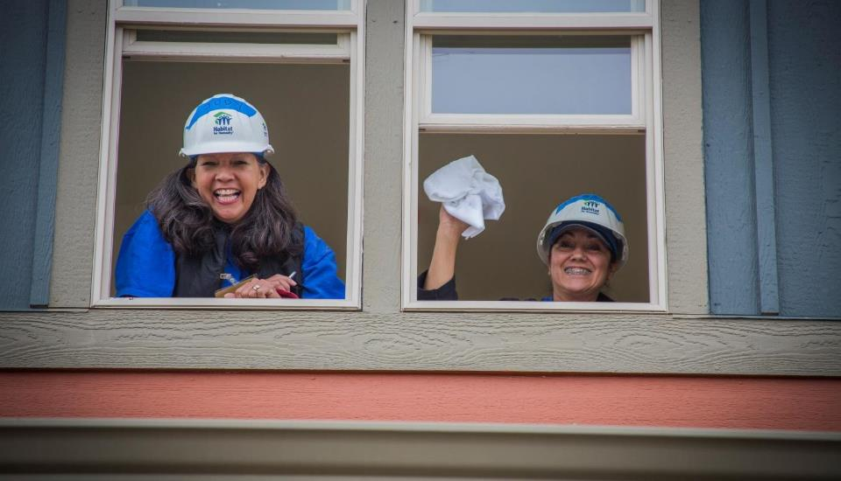
Sign up to volunteer
Contact
Mark J. Suderman, Volunteer Coordinator
www.habitatlima.org/volunteer/
mark@habitatlima.org
419-222-4937
Notes:
Let’s Get Started And sign up to Volunteer! Please note how you can contact us: through the new Habitat website, by email or phone.

Slide 31
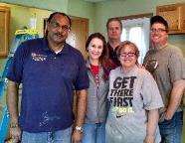



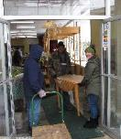

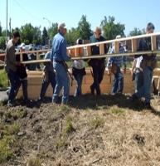








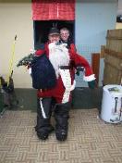
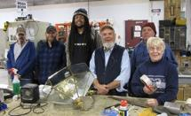




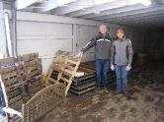
WE ARE:
HABITAT FOR HUMANITY
Lima Area
Let’s Build It!
Notes:
THANK YOU! For taking this time with me.
I hope that many of you will sign up or take information sheets or brochures and share them with colleagues or others you know.
Questions?

